Slide 1
When a Right is Wrong
Wrong
1 Corinthians 9
Dr. Rick Griffith • Crossroads International Church Singapore
cicfamily.com & BibleStudyDownloads.org

Slide 2

The Rosa Parks Story

Slide 3
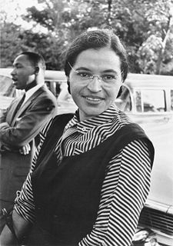
Rosa Parks
Born: Feb 4, 1913
Tuskegee, Alabama
Died: Oct 24, 2005 (age 92)
Detroit, Michigan
Rosa Parks in 1955, with Martin
Luther King, Jr. in the background

Slide 4
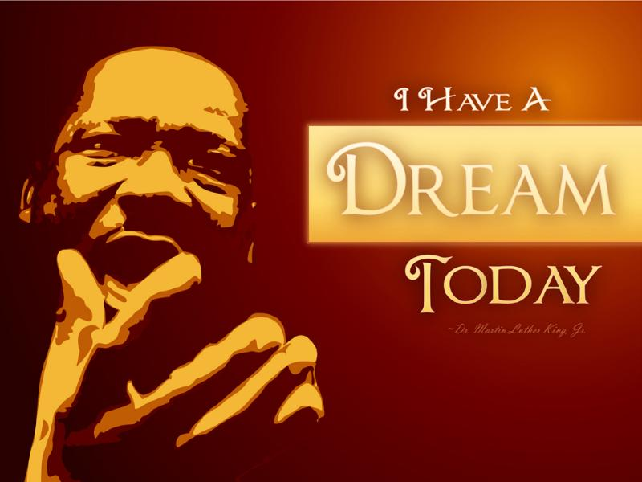
I have a dream

Slide 5
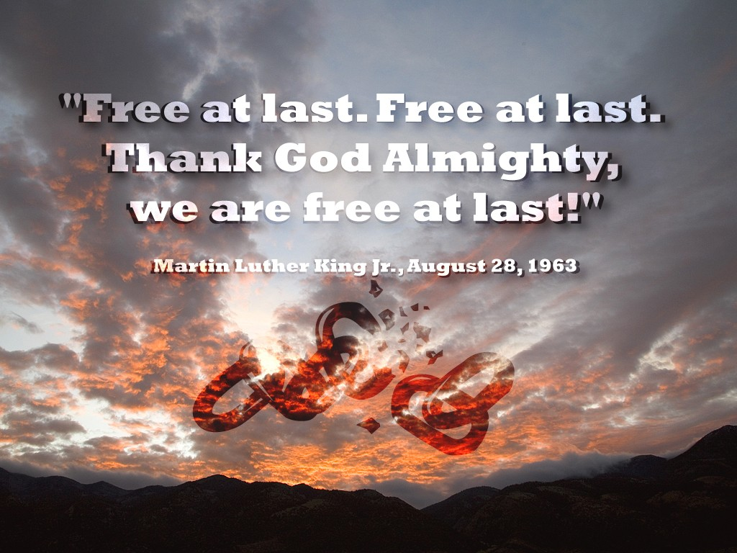
Free at last

Slide 6
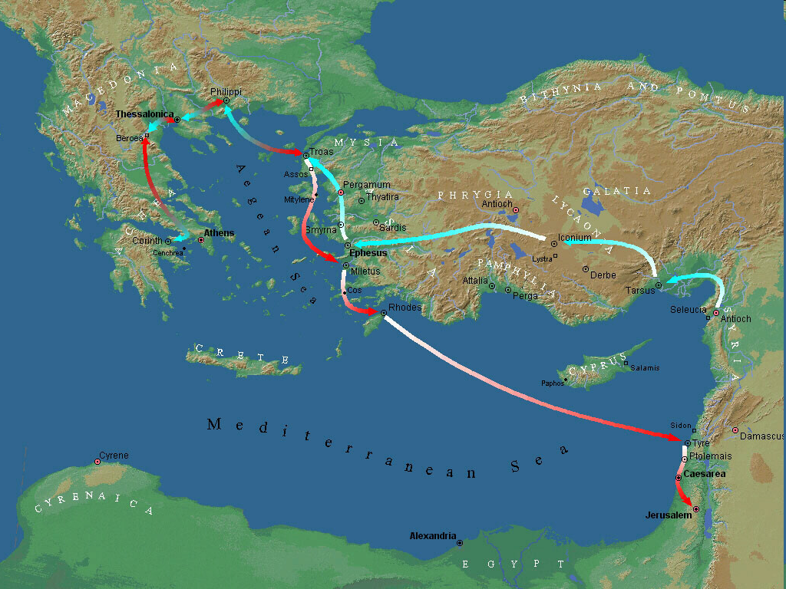
Third Missionary Journey Map
Corinth
Third Missionary Journey
A.D. 53-57

Slide 7
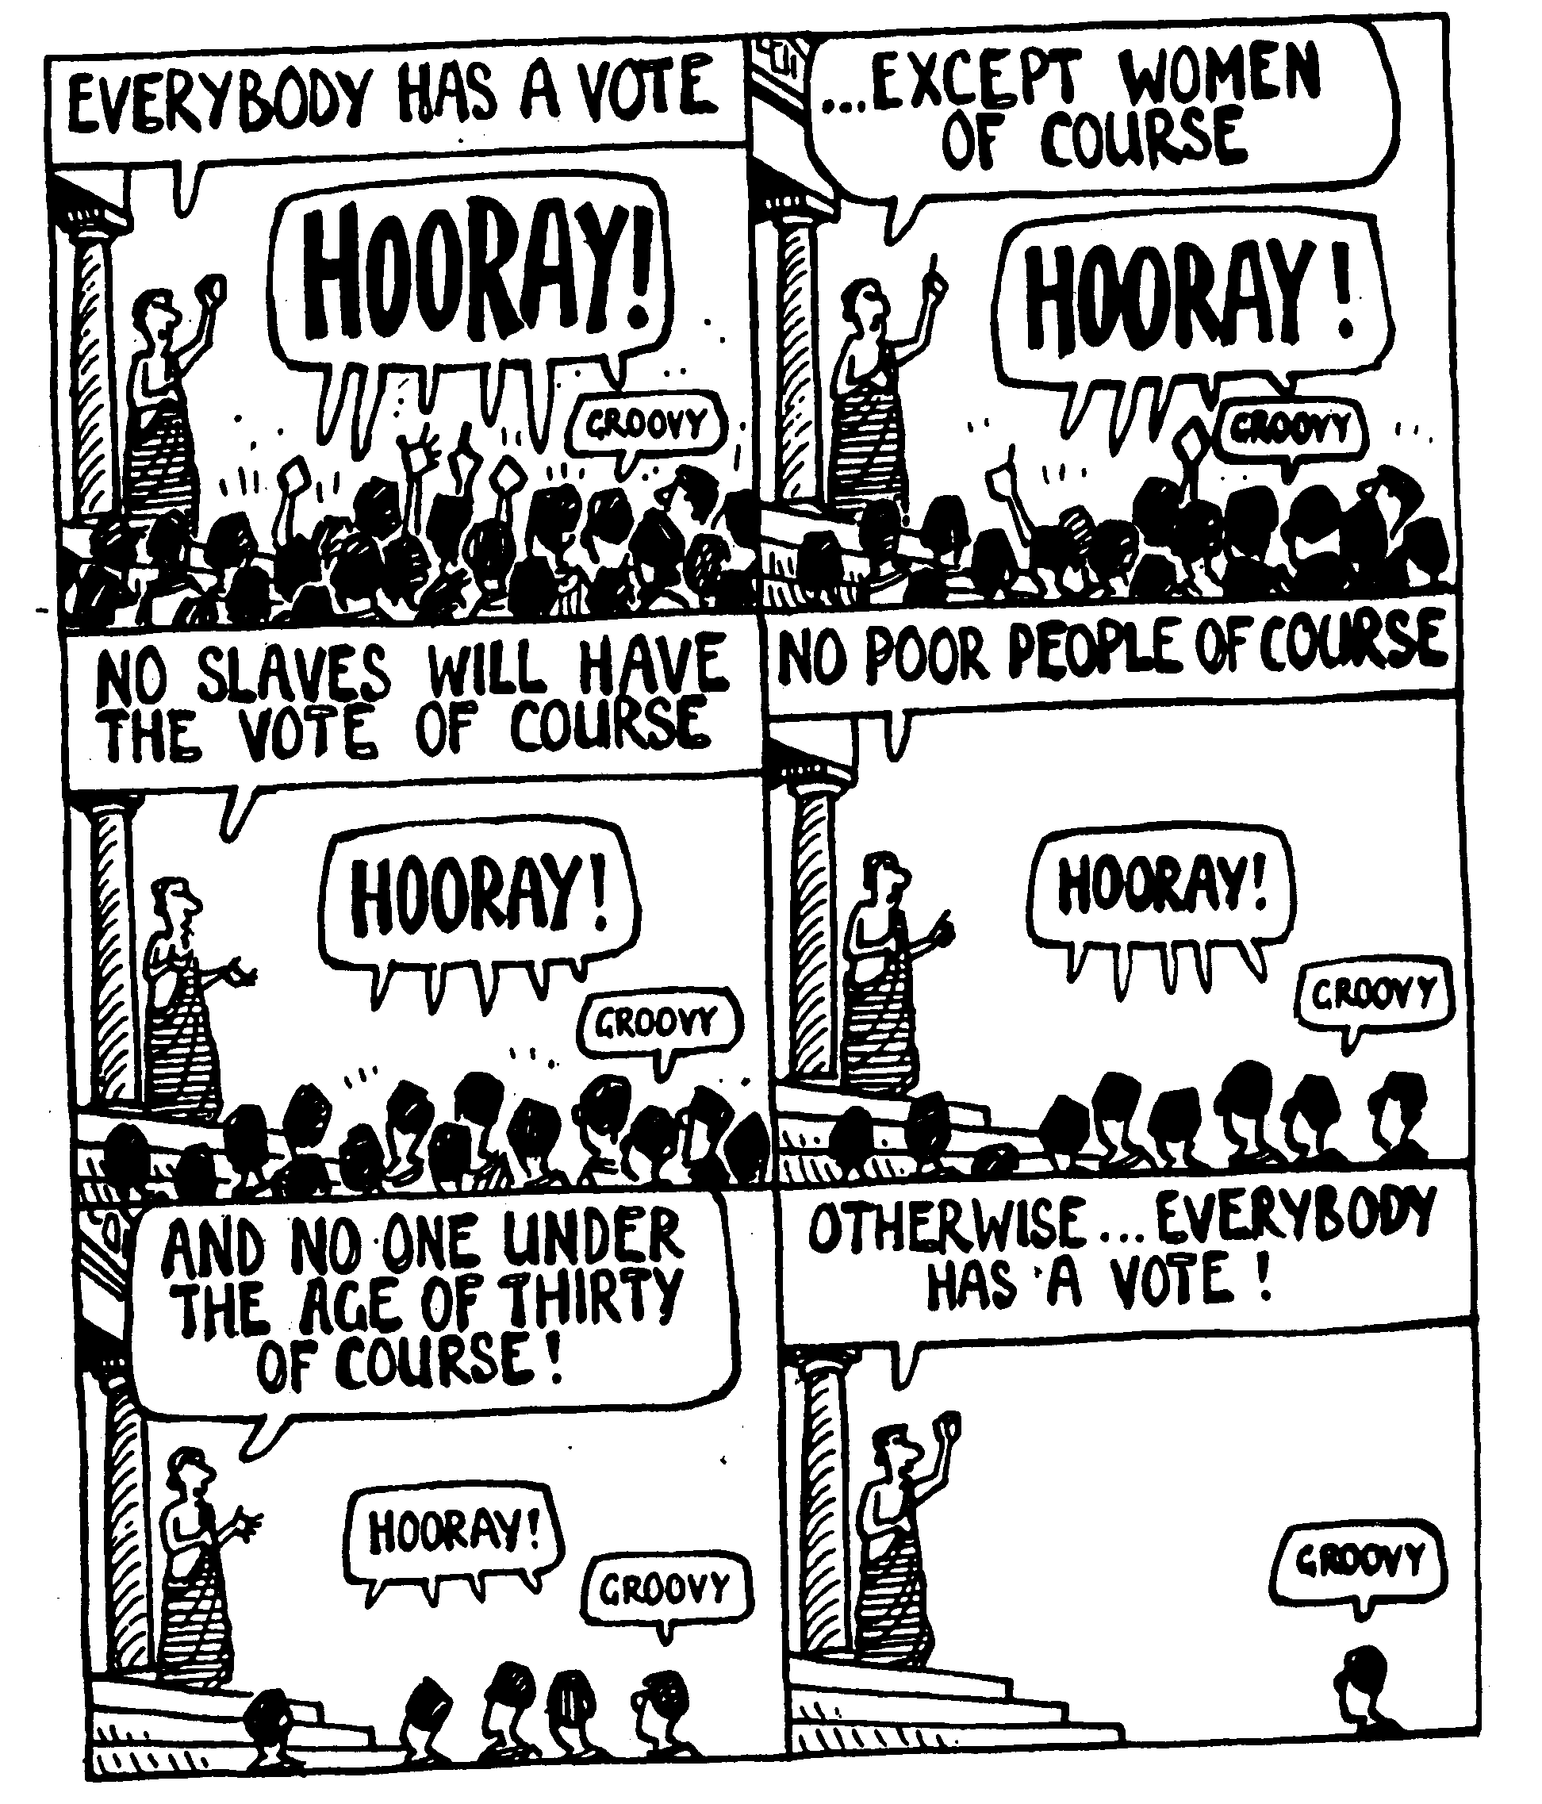
Greeks Experimented with Democracy

Slide 8
The Wayward Local Church
The Wayward Local Church
Reports
Questions
Divisions
Disorders
Difficulties
Concern
1–4
Discipline
5–6
Instruction
7–16
Carnality
3–4
Marriage 7
Worship
11–14
Factions 1–2
Incest 5
Idols 8–10
Resurrection
15
Immorality
Collection 16
Lawsuits 6
Solving church problems theologically

Slide 9

1 Corinthians 8–10
8
Meat
9
Apostles
10
Temples
8
Gray Areas

Slide 10
Black & White
Practices the Bible says are always wrong
Practices the Bible says are always right
Idolatry
Adultery
Murder
Coveting
Contentment
Obedience
Prayer
Purity

Slide 11
Gray Areas
155aa
Practices not forbidden in the Bible over which Christians disagree

Slide 12
Gray Area Examples
155aa
Accepting gifts with the left hand
Being a Democrat (or Republican!)
Buying a Mac (or Windows) computer
Celebrating Christmas or Easter
Celebrating Good Friday
Celebrating Lent
Celebrating Palm Sunday
Changing to a "Christian" name
Chinese New Year giving of hong baos

Slide 13
Gray Area Examples
155aa
Christmas trees in the church sanctuary Clapping in church services
Dancing
Drinking beer
Drinking hard liquor
Drinking wine
Driving a motorcycle
Eating bloody foods
Eating food sacrificed to idols

Slide 14
Gray Area Examples
155aa
Eating junk food
Eating meat
Eating only "Christian food"
Giving only "Christian" greetings (New Year)
Giving to non-religious causes
Having an abortionist gynecologist
Killing in war
Laughing with men and women together
Listening to rock music

Slide 15
But should we follow someone else's conscience?
FOLLOW YOUR CONSCIENCE

Slide 16
Why should we give up our rights in gray matters?
give up our rights
3 REASONS

Slide 17

I. Meekness shows love more than knowledge (1-3).

Slide 18
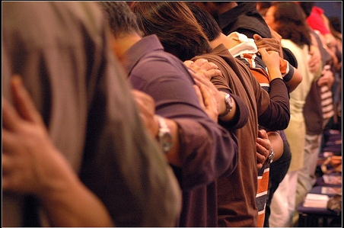
II. Meekness protects the conscience of weak believers (4-8).

Slide 19
III. Meekness keeps you from ruining the faith of a weaker brother (9-13).

Slide 20
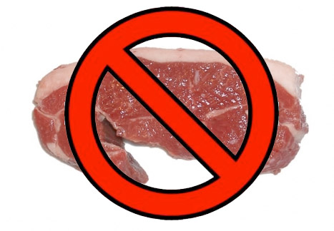
Paul's "Line"
So if what I eat causes another believer to sin, I will never eat meat again as long as I live—for I don't want to cause another believer to stumble (8:13 NLT).

Slide 21
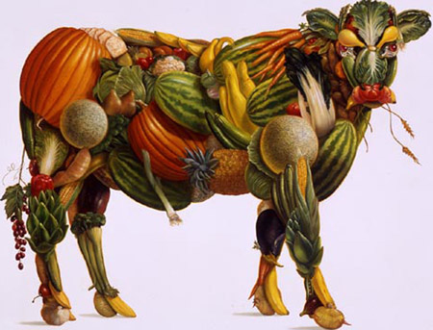
Vegeta-bull

Slide 22

Chapter 8 Big Idea:
Meekness shows love to protect the conscience and faith of weaker believers

Slide 23
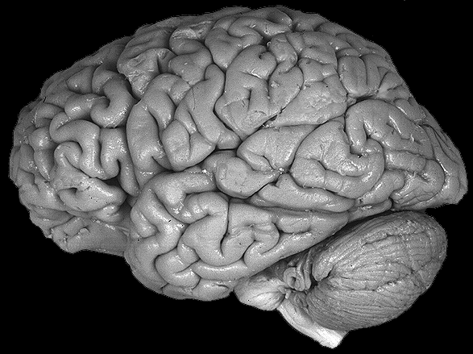
Use your brain

Slide 24
1 Corinthians 8–10
8
Meat
9
Apostles
10
Temples
8
Gray Areas
9
Rights
10
Idolatry

Slide 25
Some teach, "Believers have no rights"
?
?
?

Slide 26
Do those serving Christ have rights?
?
?
?

Slide 27
I. Servants of Christ have rights (1-14).

Slide 28
Black

Slide 29
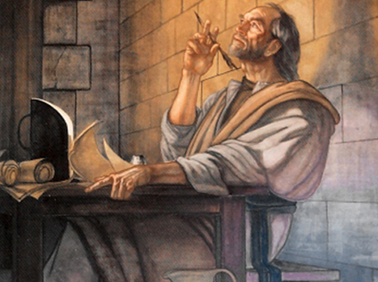
1 Cor. 9:1-2 NLT
"Am I not as free as anyone else? Am I not an apostle? Haven’t I seen Jesus our Lord with my own eyes? Isn’t it because of my work that you belong to the Lord? ²Even if others think I am not an apostle, I certainly am to you. You yourselves are proof that I am the Lord’s apostle."

Slide 30
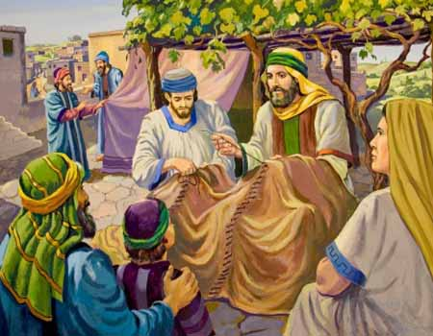
Paul proves his right to financial support (3-14)
Notes:
Craig Blomberg, NIV Application Commentary, 173

Slide 31
1 Cor. 9:3-4 NLT
"This is my answer to those who question my authority. ⁴Don’t we have the right to live in your homes and share your meals?"

Slide 32
How Greek and Roman Philosophers and Religious Teachers Were Paid in Paul's Day
• Charged fees
• Stayed with rich people
• Begged
• Worked at a trade
Notes:
Craig Blomberg, NIV Application Commentary, 173

Slide 33
How did Paul support himself?
Macedonia
$
Corinth
How did Paul support himself?

Slide 34
2 Corinthians 11:7-8
"Was it a sin for me to lower myself in order to elevate you by preaching the gospel of God to you free of charge? I robbed other churches by receiving support from them so as to serve you!"

Slide 35
Black

Slide 36

Six reasons Paul deserved financial support (6-14)
Given to other apostles (6)

Slide 37
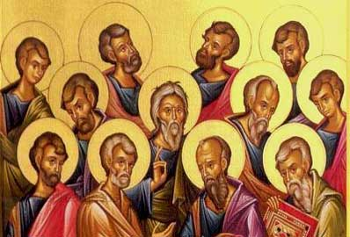
Other Apostles

Slide 38
Six reasons Paul deserved financial support (6-14)
Given to other apostles (6)
Given to all "secular" workers (7)

Slide 39
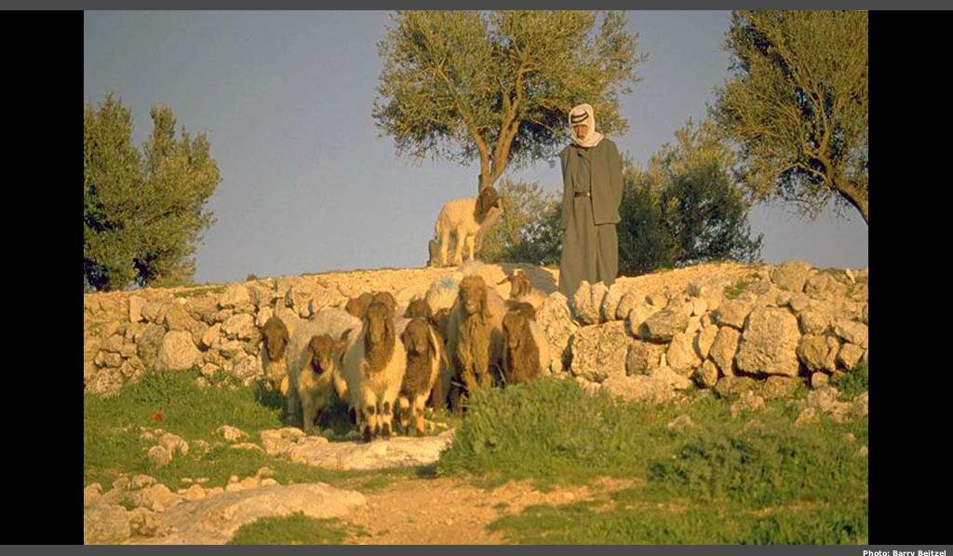
Shepherd

Slide 40
Six reasons Paul deserved financial support (6-14)
Given to other apostles (6)
Given to all "secular" workers (7)
Scriptural for oxen & people (8-11)

Slide 41
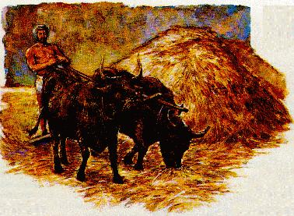
Don't muzzle the ox

Slide 42
Six reasons Paul deserved financial support (6-14)
Given to other apostles (6)
Given to all "secular" workers (7)
Scriptural for oxen & people (8-11)
Given to other church planters (12)

Slide 43
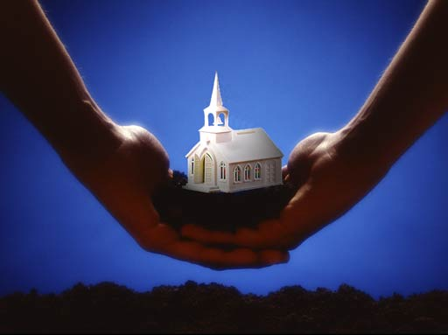
Other Church Planters

Slide 44
Six reasons Paul deserved financial support (6-14)
Given to other apostles (6)
Given to all "secular" workers (7)
Scriptural for oxen & people (8-11)
Given to other church planters (12)
Given to other religious workers (13)

Slide 45

Food for priests

Slide 46
Six reasons Paul deserved financial support (6-14)
Given to other apostles (6)
Given to all "secular" workers (7)
Scriptural for oxen & people (8-11)
Given to other church planters (12)
Given to other religious workers (13)
Jesus ordained financial support for those who serve Him (14; cf. Lk 10:7)

Slide 47
Those reaching others for Christ today also have rights

Slide 48
Black

Slide 49
II. Give up any right that hinders the gospel (15-27).

Slide 50
Black

Slide 51
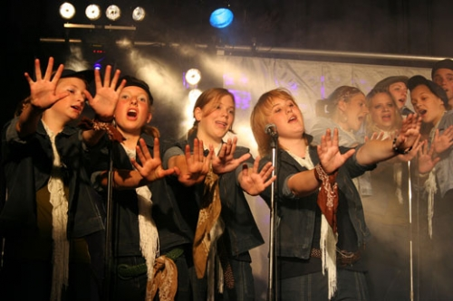


We also have joy when giving up our rights draws people to Christ

Slide 52
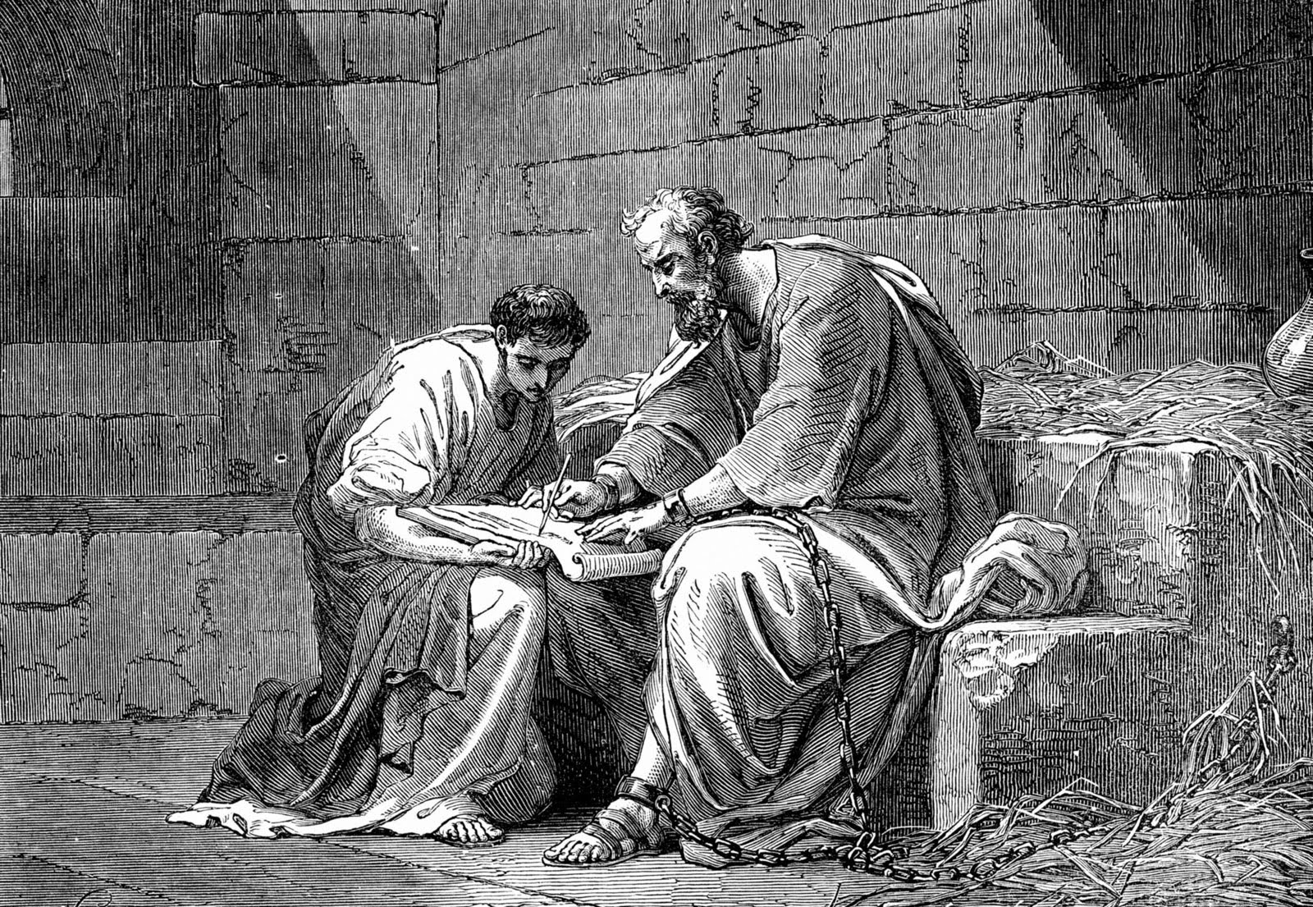
Paul gave up rights to help Jews, Gentiles and weak Christians mature in Christ (19-23)
All (19)
Jews (20)
Gentiles (21)
Weak (22a)
Motive (22b-23)

Slide 53
Paul was not under the Law
"When I was with the Jews, I lived like a Jew to bring the Jews to Christ. When I was with those who follow the Jewish law, I too lived under that law. Even though I am not subject to the law, I did this so I could bring to Christ those who are under the law"
1 Corinthians 9:20 NLT

Slide 54

Focus on the Goal (1 Cor. 9:24-27)

Slide 55
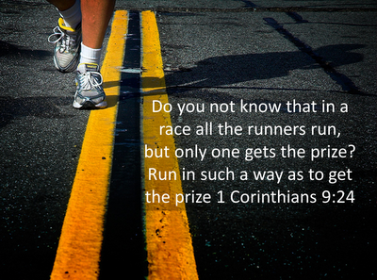
Focus on the Goal (1 Cor. 9:24-27)

Slide 56


We should give up any right that hinders drawing people to Christ like an athlete denies himself to win a temporal wreath (24-27)

Slide 57
Give up your rights to help others mature in Christ
(Main Idea)

Slide 58
Rosa Parks

Slide 59
When a Right is Wrong
Wrong
It's right to give up a right

Slide 60
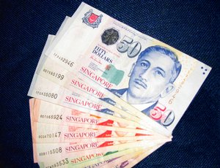

Which Right?
Money?
Time?

Slide 61
Black

Slide 62


NT Preaching link at BibleStudyDownloads.org
Get this presentation and script for free!
Notes:
NT Preaching (np)

